Slide 1


Service Provider Management System
Divye Kotwal
Imanjot Singh
Shreyash Thakur
Suchita Vibhor
Sai Swapnik Tej

Slide 2
Introduction
Service Provider is one who wants to get his customer to pay him through the IBS Portal
Service Provider registers via the IBS Portal
A bank representative has to approve/disapprove Service Provider registration
Bank representative needs to assign unique SPI for approved service providers
Post registration client will be able to check his status by logging into the portal

Slide 3

Requirements
Must have an account with our bank or with any other Bank
Register along with KYC and account details in which the payments would be received.

Slide 4
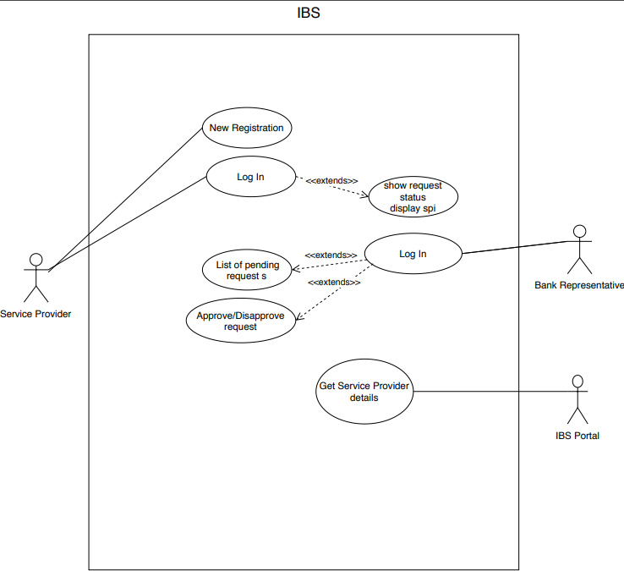
Use Case Diagram

Slide 5
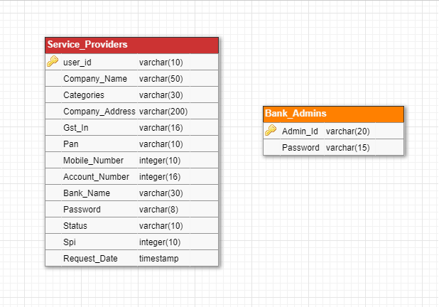
Database

Slide 6
GOT ANY QUESTIONS?
Thank you

